Slide 1

Corona Says: Nature's Voice Through Poetry
Welcome to our exploration of "Corona Says" by Vishnu S. Rai. This powerful poem gives voice to the coronavirus, challenging us to rethink our relationship with nature.
I'm Pragyan Thapaliya, your guide on this thought-provoking journey. Let's begin!
by Pragyan Thapaliya

Slide 2

Unveiling the Poem's Essence
1
Nature's Messenger
2
Direct Dialogue
"Corona Says" portrays the virus as a consequence of humanity's impact on nature.
The coronavirus speaks to humans, prompting reflection on our environmental actions.
3
Global Crisis
The poem addresses the broader environmental crisis through the lens of the pandemic.

Slide 3
The Unwelcome Guest
Invitation
Human Actions
Nature's Warning
The virus claims it was invited, not arriving by choice.
Environmental neglect and pollution are portrayed as the true culprits.
The virus serves as a reminder of the consequences of our choices.

Slide 4

A Mirror to Humanity
1
Historical Context
The virus questions humanity's long history of violence and destruction.
2
Comparative Suffering
It suggests that human-inflicted pain far outweighs the virus's impact.
3
Reflection Point
This stanza prompts us to consider our role in global suffering.

Slide 5
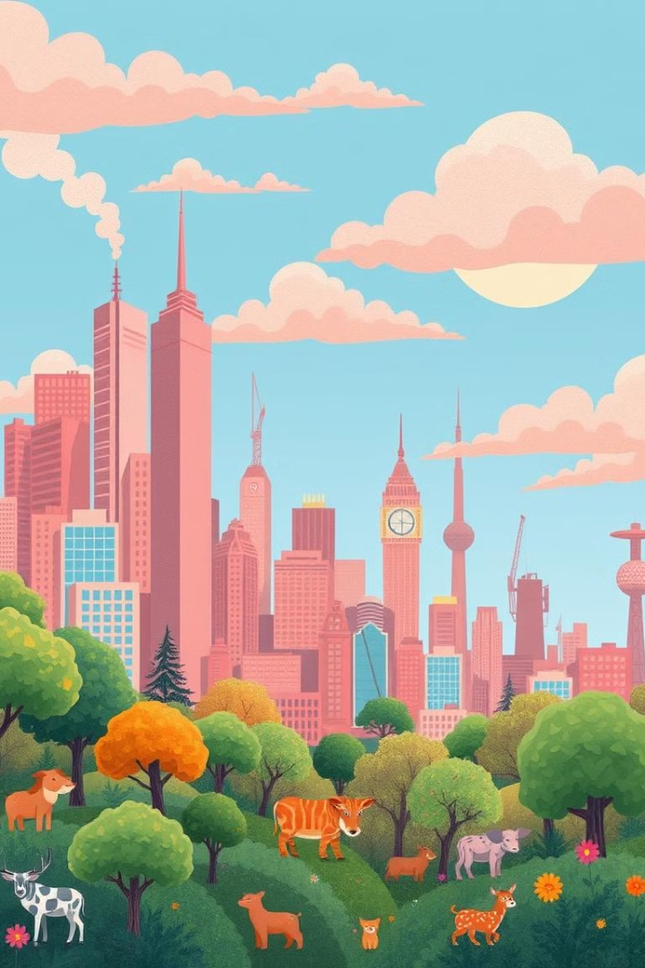
Nature's Temporary Respite
Clear Skies
Wildlife Revival
Lockdowns revealed how quickly nature can heal without human interference.
Animals reclaimed spaces, showing nature's resilience when given a chance.
Earth's Breath
The poem highlights how the planet flourished during this brief pause.

Slide 6




A Cautionary Tale
Inflated Ego
The virus warns against human arrogance and disregard for nature.
Regression Warning
It cautions that unchecked behavior could lead to societal regression.
Cycle of Destruction
The poem suggests that without change, we risk repeating past mistakes.

Slide 7
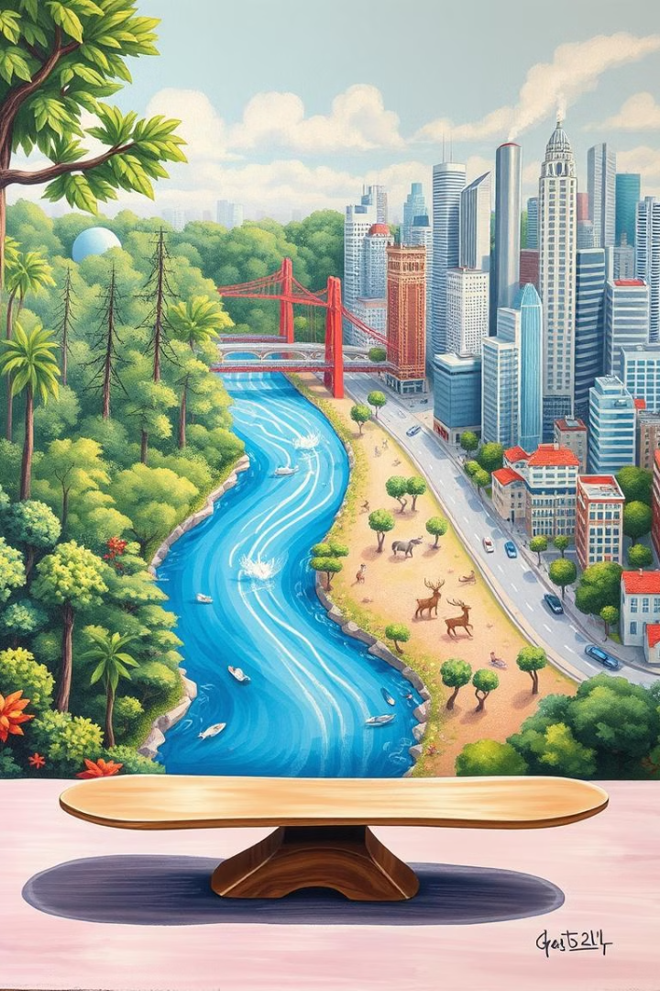



Lessons from the Virus
Respect Nature's Balance
The poem emphasizes the importance of maintaining ecological equilibrium.
Learn from Adversity
The virus is portrayed as a teacher, not just a destroyer.
Embrace Change
By altering our ways, we can prevent future environmental catastrophes.

Slide 8

Our Path Forward
1
Reflect
Consider our individual and collective impact on the environment.
2
Act
Implement sustainable practices in our daily lives and communities.
3
Sustain
Commit to long-term environmental stewardship for a healthier planet.
Thank you for joining this journey through "Corona Says". Let's work together for a sustainable future!

Slide 9

This Photo by Unknown Author is licensed under CC BY-SA

